Slide 1

Case study E-commerce platform
By: Ishaan Raghav

Slide 2


HUMAN RESOURCE OUTSOURCING
Human resource outsourcing refers to a process in which the employer transfers responsibilities and risks for HR functions to the external provider which performs this tasks for the company. Since HR functions can be complex and time-consuming business opt for outsourcing either whole HR logistics or part of the HR responsibilities like payroll.
HR outsourcing services
• Recruiting, training, and development
• Overseeing organizational structure and staffing requirements
• Tracking department objectives, goals and strategies
• Employee orientation programs

Slide 3
Voofies
What Can We Get You?

Slide 4

ABOUT Voofies
We wish to establish a platform for the Tier 2 & 3 Cities that will enable them with the service to order products in the field of pharmacy, grocery, food, and other hyperlocal areas.

Slide 5
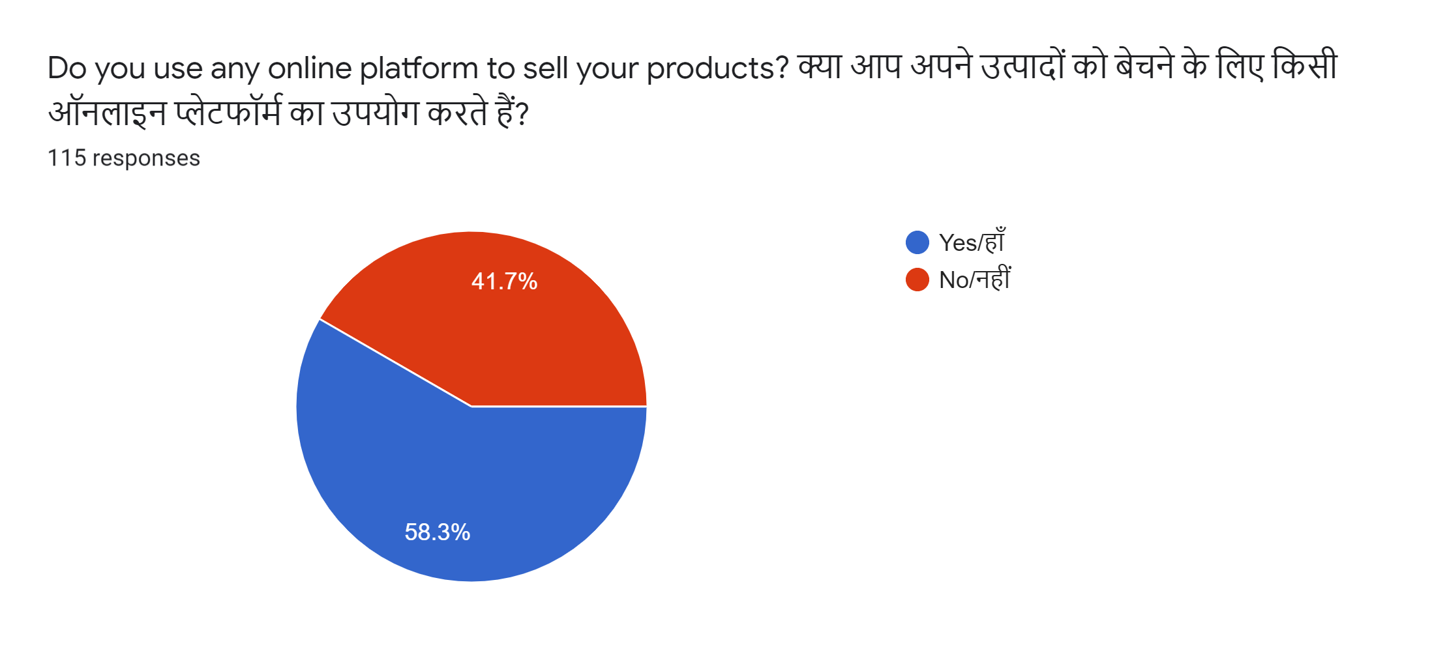
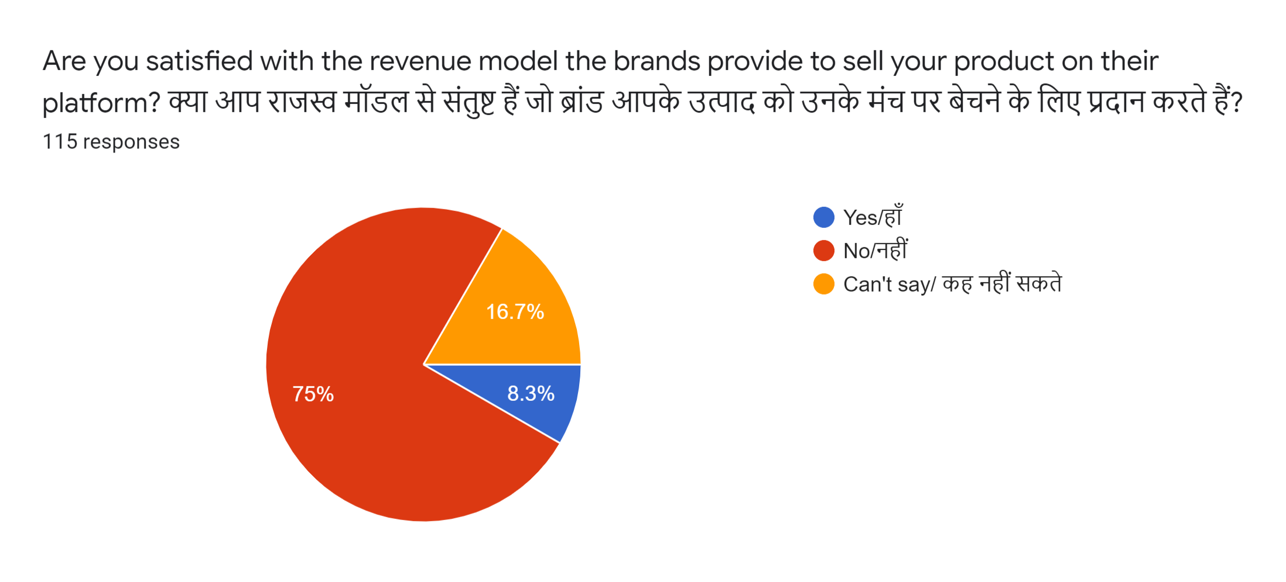
PROBLEM
The inability of businesses to go online due to limited funds/ insufficient knowledge.
A Comprehensive Study
The reluctance of our respondents to work according
to the current revenue model as this causes them
very little profit.

Slide 6
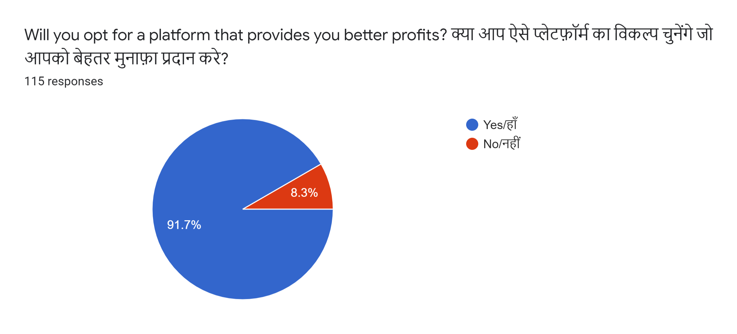
PROBLEM
The current revenue model for shops & wholesale retailers is very little profitable and hence they need some alternative to boycott the current options.
A Comprehensive Study (Contd.)

Slide 7
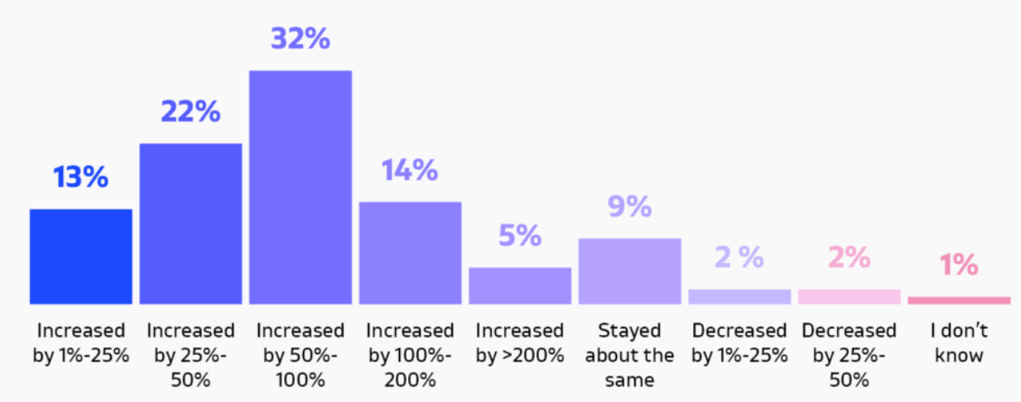
Effect of Covid-19 on revenue at various merchants
Aim:
Get knowledgeable on how has the Covid-19 affected merchants across various sectors of Ecommerce.

Slide 8
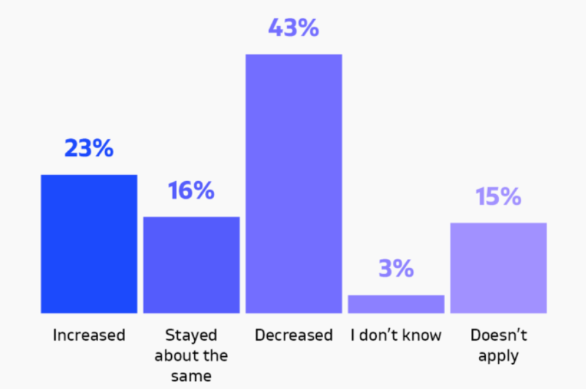
How has your Offline Sales changed in 2020 as compared to previous years?
Aim:
To find how Effective can a new Ecommerce platform like Voofies be in such a condition?

Slide 9
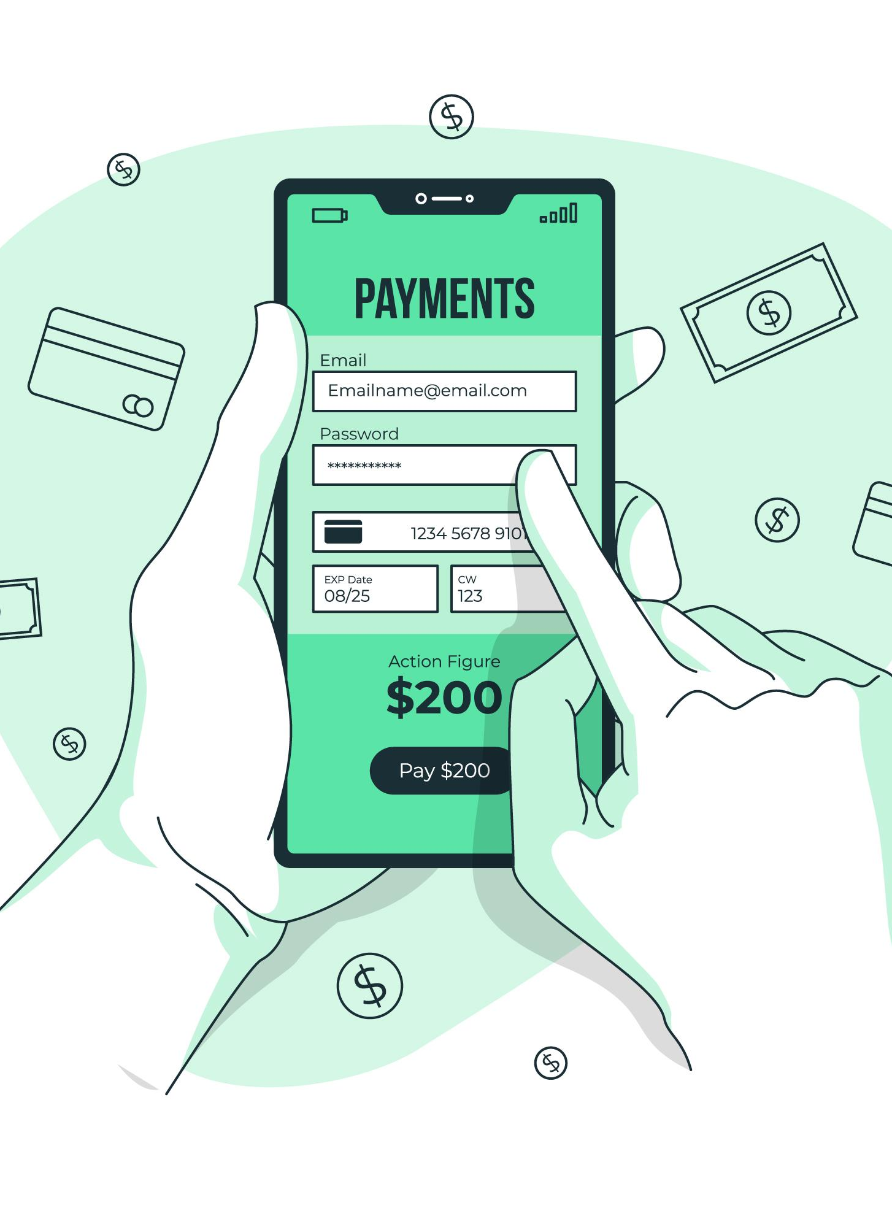
SOLUTION
Provide a platform for the people especially belonging to the Tier 2 & 3 cities from where they can order their required products like pharmacy, food, and other daily essentials while promoting #digitalindia, #atmanirbharbharat, #vocalforlocal.
Our respondents are pretty sure that if such a platform is provided to them that provides better earnings, they’ll surely get in touch with us.

Slide 10
SOLUTION
Providing a stable revenue model to the shops will definitely help in getting more profits to them from existing customers/brands.
We’ve proposed:
10% app maintenance +
1.75% Payment Gateway charges)
= 11.75%

Slide 11

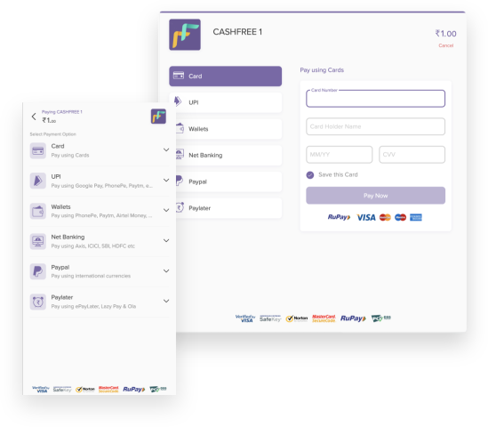
Outsourcing of Payment Portal
We power payments (collection and disbursals) for 50k + Indian and global businesses including Zomato, Cred, and ClubFactory. We are a Y Combinator company, incubated by PayPal. In 2019, we crossed 1Million daily transactions.
CashFree, our finalized payment portal CHARGES AN AMOUNT OF 1.75% on every transaction that is done through its portal

Slide 12
Sources of Revenue

Slide 13
Traction & Audience
1
2
3
Target Audience
Premium Program
Experts
Voofies intended interest group incorporates individuals between 18 to 35 years old who approach cell phones and are agreeable in utilizing applications. It targets two sorts of clients: The primary gathering incorporates individuals who need to arrange their nourishment home and the subsequent gathering incorporates individuals who like to feast out.
It offers nourishment conveyance to the individuals who need it conveyed just as we would offer motivators to individuals to eat out through our premium program.
Working experts who need nourishment in their workplaces, understudies who need nourishment in their inns, individuals who don't have time or space to cook for themselves, and individuals who at times prefer to eat outside

Slide 14
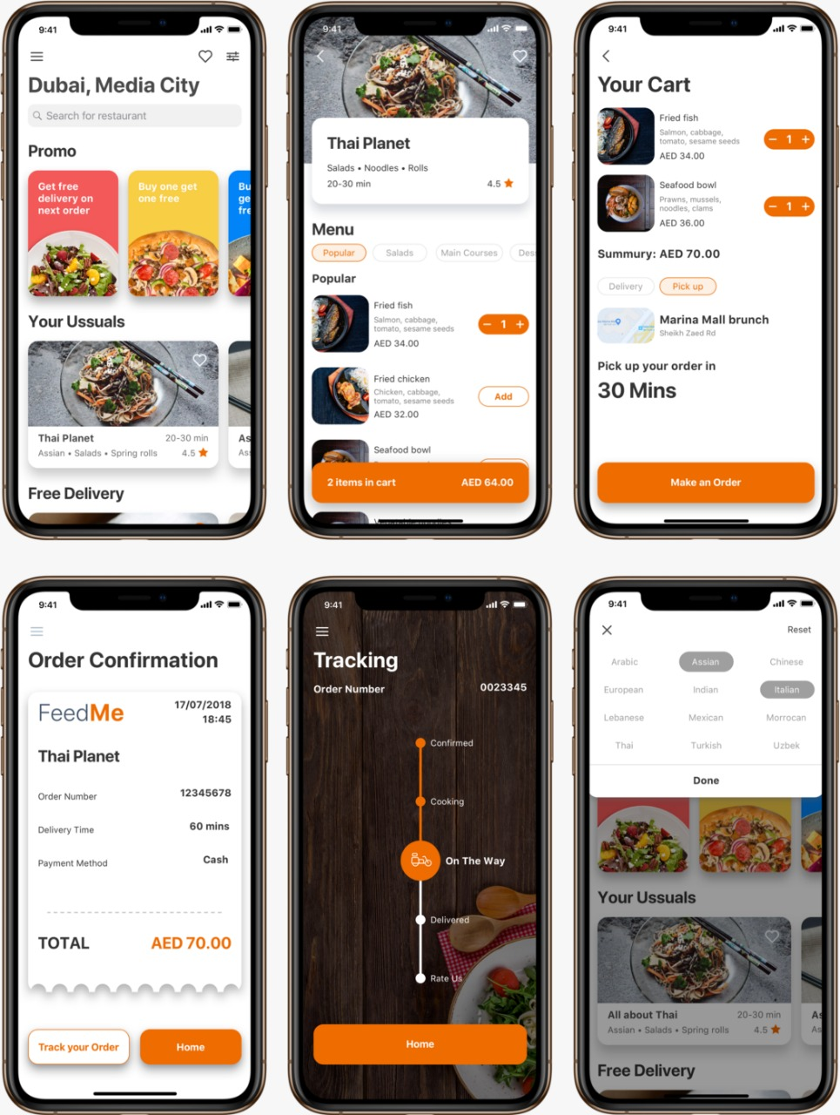
Our App
The following is the UI of the application
That has been designed and approved by
all board members and authorities.

Slide 15








COMPETITION PART
More Convenient
Swiggy
Big Basket
Zomato
Grofers
More Expensive
Less Expensive
Grab Hub
Deliveroo
Door Dash
Less Convenient
Postmates

Slide 16


Can we relate traditional petroleum industry with New Age Technology, specifically Ecommerce Platform?
A Competitive Case Study:
There are online platforms that enable you to buy petroleum products like petrol, diesel, kerosene, but due to governmental norms they restrain from any other purpose rather than just fueling up your vehicle.
A few of these platforms are:

Slide 17
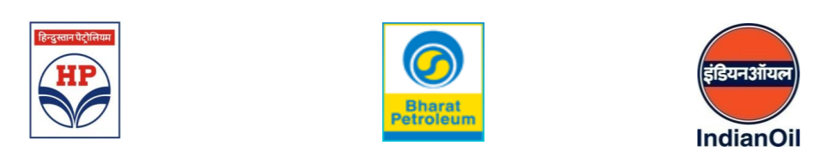
DOOR-TO DOOR DELIVERY (DDD) OF HIGH SPEED DIESEL THROUGH START-UPS: AN INITIATIVE BY IOCL
According to IOCL, startups or organizations that adhere to the following conditions are allowed to sell petroleum products for fueling purposes at home:
Start-ups will be required to register themselves as “DDD Resellers” of Oil Marketing Companies (OMC) and will also be required to sign an Agreement with the concerned OMC. Such start-ups will be called FuelEnts (Fuel + Entrepreneurs).
Eligible Start-ups registered as “DDD Resellers” will be able to procure HSD directly from supply locations of OMCs or its Retail Outlets, having facility for loading of such Mobile Dispensers.

Slide 18
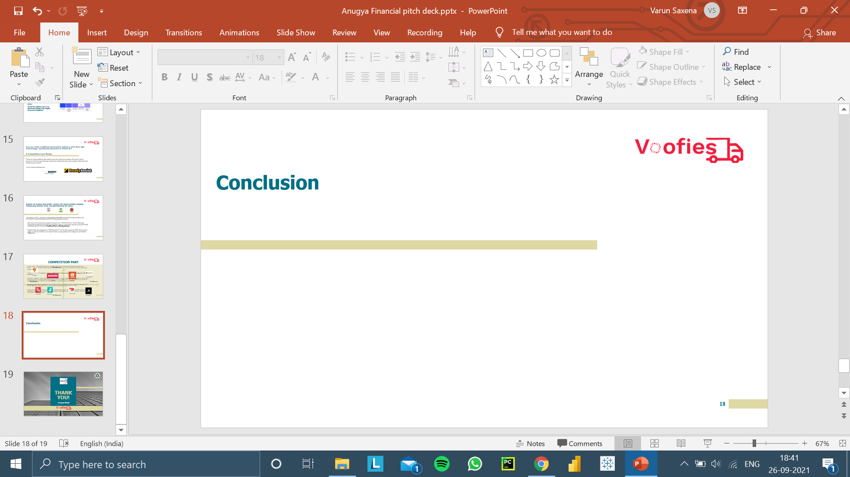
Conclusion
Wipro enables data transformation & migration for Oil & Gas supermajor that will enable us to proactively work towards connecting the dots between Oil & Gas sector and modern day technology, Ecommerce.
Voofies will provide customers in the tier 2 & 3 cities with an important first touchpoint with a business.
Just like ecommerce, O&G supermajor unlocks value of digital portal for retail, commercial businesses and helps sellers to compare the products using tools or on their own. This gives them a good idea of product alternatives available, the standard rates, if a product need is unfulfilled.
Reaching out to more customers - Sellers that need to expand their reach to find new customers can benefit from this. This applies to online-only sellers and those with a physical store.
Sellers don’t have to spend a lot of money to promote their items. The world of ecommerce has several affordable, quick ways to market online. Ecommerce marketplaces are visual channels – and sellers can really show off their product.

Slide 19
THANK YOU!

